Slide 1

Interim Report – NLP Final Project
Analyzing Mental Health:
Text Classification for Mental Health Conditions
Course Lecturer: Dr. Alexander(Sasha) Apartsin
Shahar Saadon | 206560526
Dudi Saadia | 318970944
Shanel Asulin | 205616014

Slide 2
Project Description
Data
Challenges
Evaluation Metrics
Task Type: Multi-class Text Classification
Input: Free-form short English texts (social media statements)
Output: One of 7 mental health labels
Labels: Normal, Depression, Suicidal, Anxiety, Stress, Bi-Polar, Personality Disorder
Dataset: Combined labeled dataset from Kaggle (53,000+ rows)
Format: CSV with two columns: statement (text), status (label)
Informal and varied mental health expressions
Ambiguous/self-diagnosed language
Imbalanced classes (e.g., fewer suicidal statements)
Label noise and missing data
Accuracy – Correct predictions rate
Precision – Correctness of positive classifications
Recall – Sensitivity to each class
F1-score – Harmonic mean of precision and recall
Confusion Matrix – Error analysis

Slide 3
Literature Review
Study | Dataset & Task | Methods | Best Result | Key Contribution
Nova (2023) | 10K Reddit posts (6 conditions) | Naive Bayes, MLP, LightGBM | 77% (LightGBM) | TF-IDF text features, simple yet effective
Ameer et al. (2022) | 17K Reddit posts (5 classes) | Traditional ML, DL, RoBERTa | 83% (RoBERTa) | Multi-model benchmark with deep/transfer learning
Dinu & Moldovan (2021) | 100K Reddit posts (9 DSM-5 conditions) | BERT, XLNet, RoBERTa | 81% (RoBERTa) | Detection from general text, not only support forums

Slide 4

Work Plan
Completed so far
Data preprocessing – loaded, cleaned and verified dataset (53K+ samples).
Text vectorization – applied TF-IDF to convert text to numerical features.
Baseline model – trained and evaluated Naïve Bayes classifier.
Modeling – trained Logistic Regression and Linear SVM models.
Evaluation – generated classification reports and confusion matrices.
Next steps
Feature optimization – try n-grams, max_features, etc.
Advanced modeling – experiment with BERT or RoBERTa.
Error analysis – inspect misclassified samples, refine labels if needed.
Visualization – add label distributions, top words, and confusion matrix plots.

Slide 5
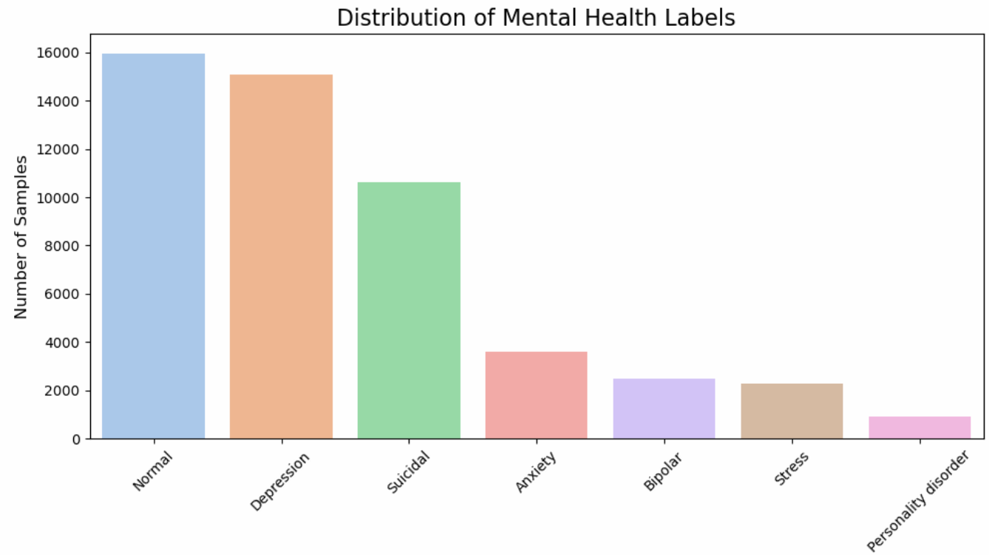
1.
SVM (LinearSVC) | Logistic regression | Naïve bayes | Metric
0.74 | 0.75 | 0.67 | Accuracy
0.69 | 0.68 | 0.51 | Marco F1 score
0.74 | 0.74 | 0.65 | Weighted F1 score
2.

Slide 6
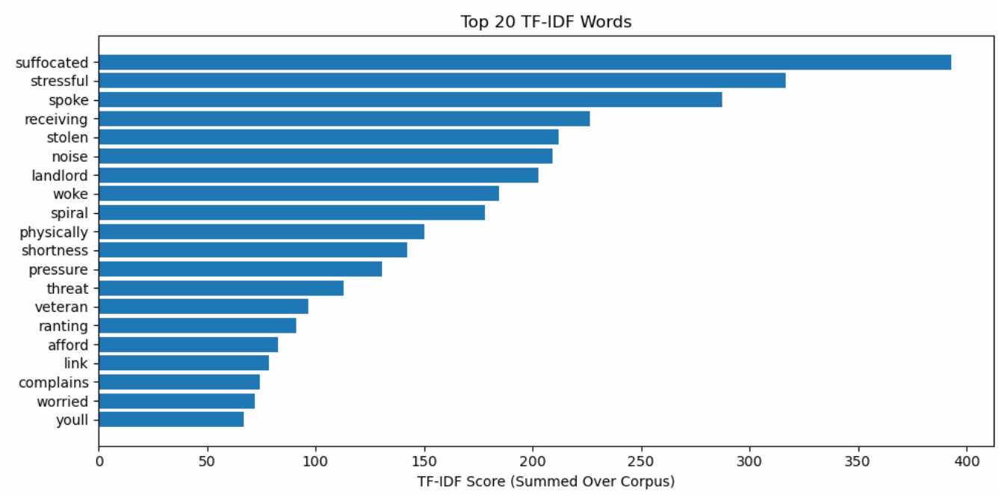
3.

Slide 7
Key Insights & Next Steps
Baseline models like Naive Bayes, Logistic Regression, and SVM performed well on clearer categories (e.g., Normal, Depression) but struggled with more ambiguous ones like Stress and Personality Disorder.
Class imbalance had a noticeable impact on performance, especially in the Macro F1-score, emphasizing the importance of using multiple evaluation metrics.
TF-IDF helped identify high-impact words, but it lacks the ability to understand deeper semantic context or word meaning in relation to surrounding words.
Moving forward, we'll explore context-aware models like BERT or RoBERTa, which are better suited for capturing emotional subtleties and complex phrasing.

Slide 8
Thank You ☺

